Slide 1
Building Apps with React Native
Alan.Alvarez@icims.com
Software Developer Mobile Team

Slide 2
Agenda
What is React Native?
How does it work?
Pros and Cons
Introduction to Flexbox
Popular Apps built with React Native
iCIMS Hackathon API
Let’s build a Job Applications App
Diving into the Code
Advanced topics
State Management with Redux
Static typing using Flow or Typescript

Slide 3
What is React Native?
React Native = React JS + Native API Wrapper + Communication Bridge.
Instead of Virutal DOM rendering div, we render UIView and View on native side.

Slide 4
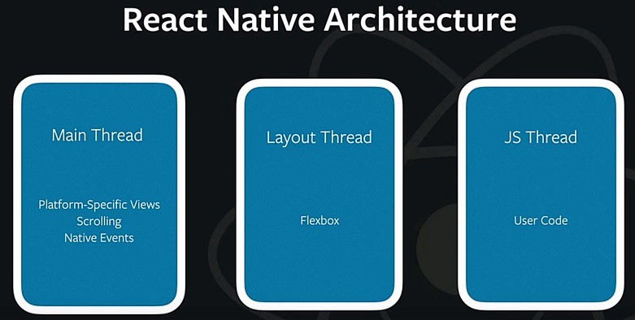
How does it work? Run-time
4 Threads and Areas of Responsibilities
Main Thread (UI Thread)
Shadow Queue (Layout/Flexbox/Yoga)
JS Engine
Native Modules
iOS: GCD Queue per Module
Android: Thread Pool

Slide 5
How does it work? – Native Modules
All Communications happen through the bridge
Bridge: Asynchronous, serialized and batched.

Slide 6
Popular Apps built with React Native
Facebook and Facebook Ads
MS Office: All UI for MS Office except Desktop which use electron.
Uber EATS. (Restaurant and User apps. iOS, Android and Web)
Instagram
Airbnb
Discord
Pinterest
Artsy
Notes:
``

Slide 7
Pros
Learn once, write everywhere. Not write once, run everywhere.
ie: Use React Web for Mobile development.
Leverage React JS knowledge if any.
Nonetheless a lot of shared code. (Real: Microsoft, Uber, airbnb and Discord)
Rapid prototyping and Development.
Performance is not an inherent issue.

Slide 8
Cons
Javascript Dynamic typing
Small startup delay
It’s a relatively new platform (when compared to iOS UIKit and Android); React Native was announced on February 2015.

Slide 9
Introduction to Flexbox
Same CSS Flexbox semantics.
Flexbox works the same way in React Native as it does in CSS on the web, with a few exceptions. The defaults are different, with flexDirection defaulting to column instead of row, and the flex parameter only supporting a single number.
https://facebook.github.io/react-native/docs/flexbox
http://www.reactnativeexpress.com/flexbox
http://www.flexboxdefense.com/
https://flexboxfroggy.com/

Slide 10
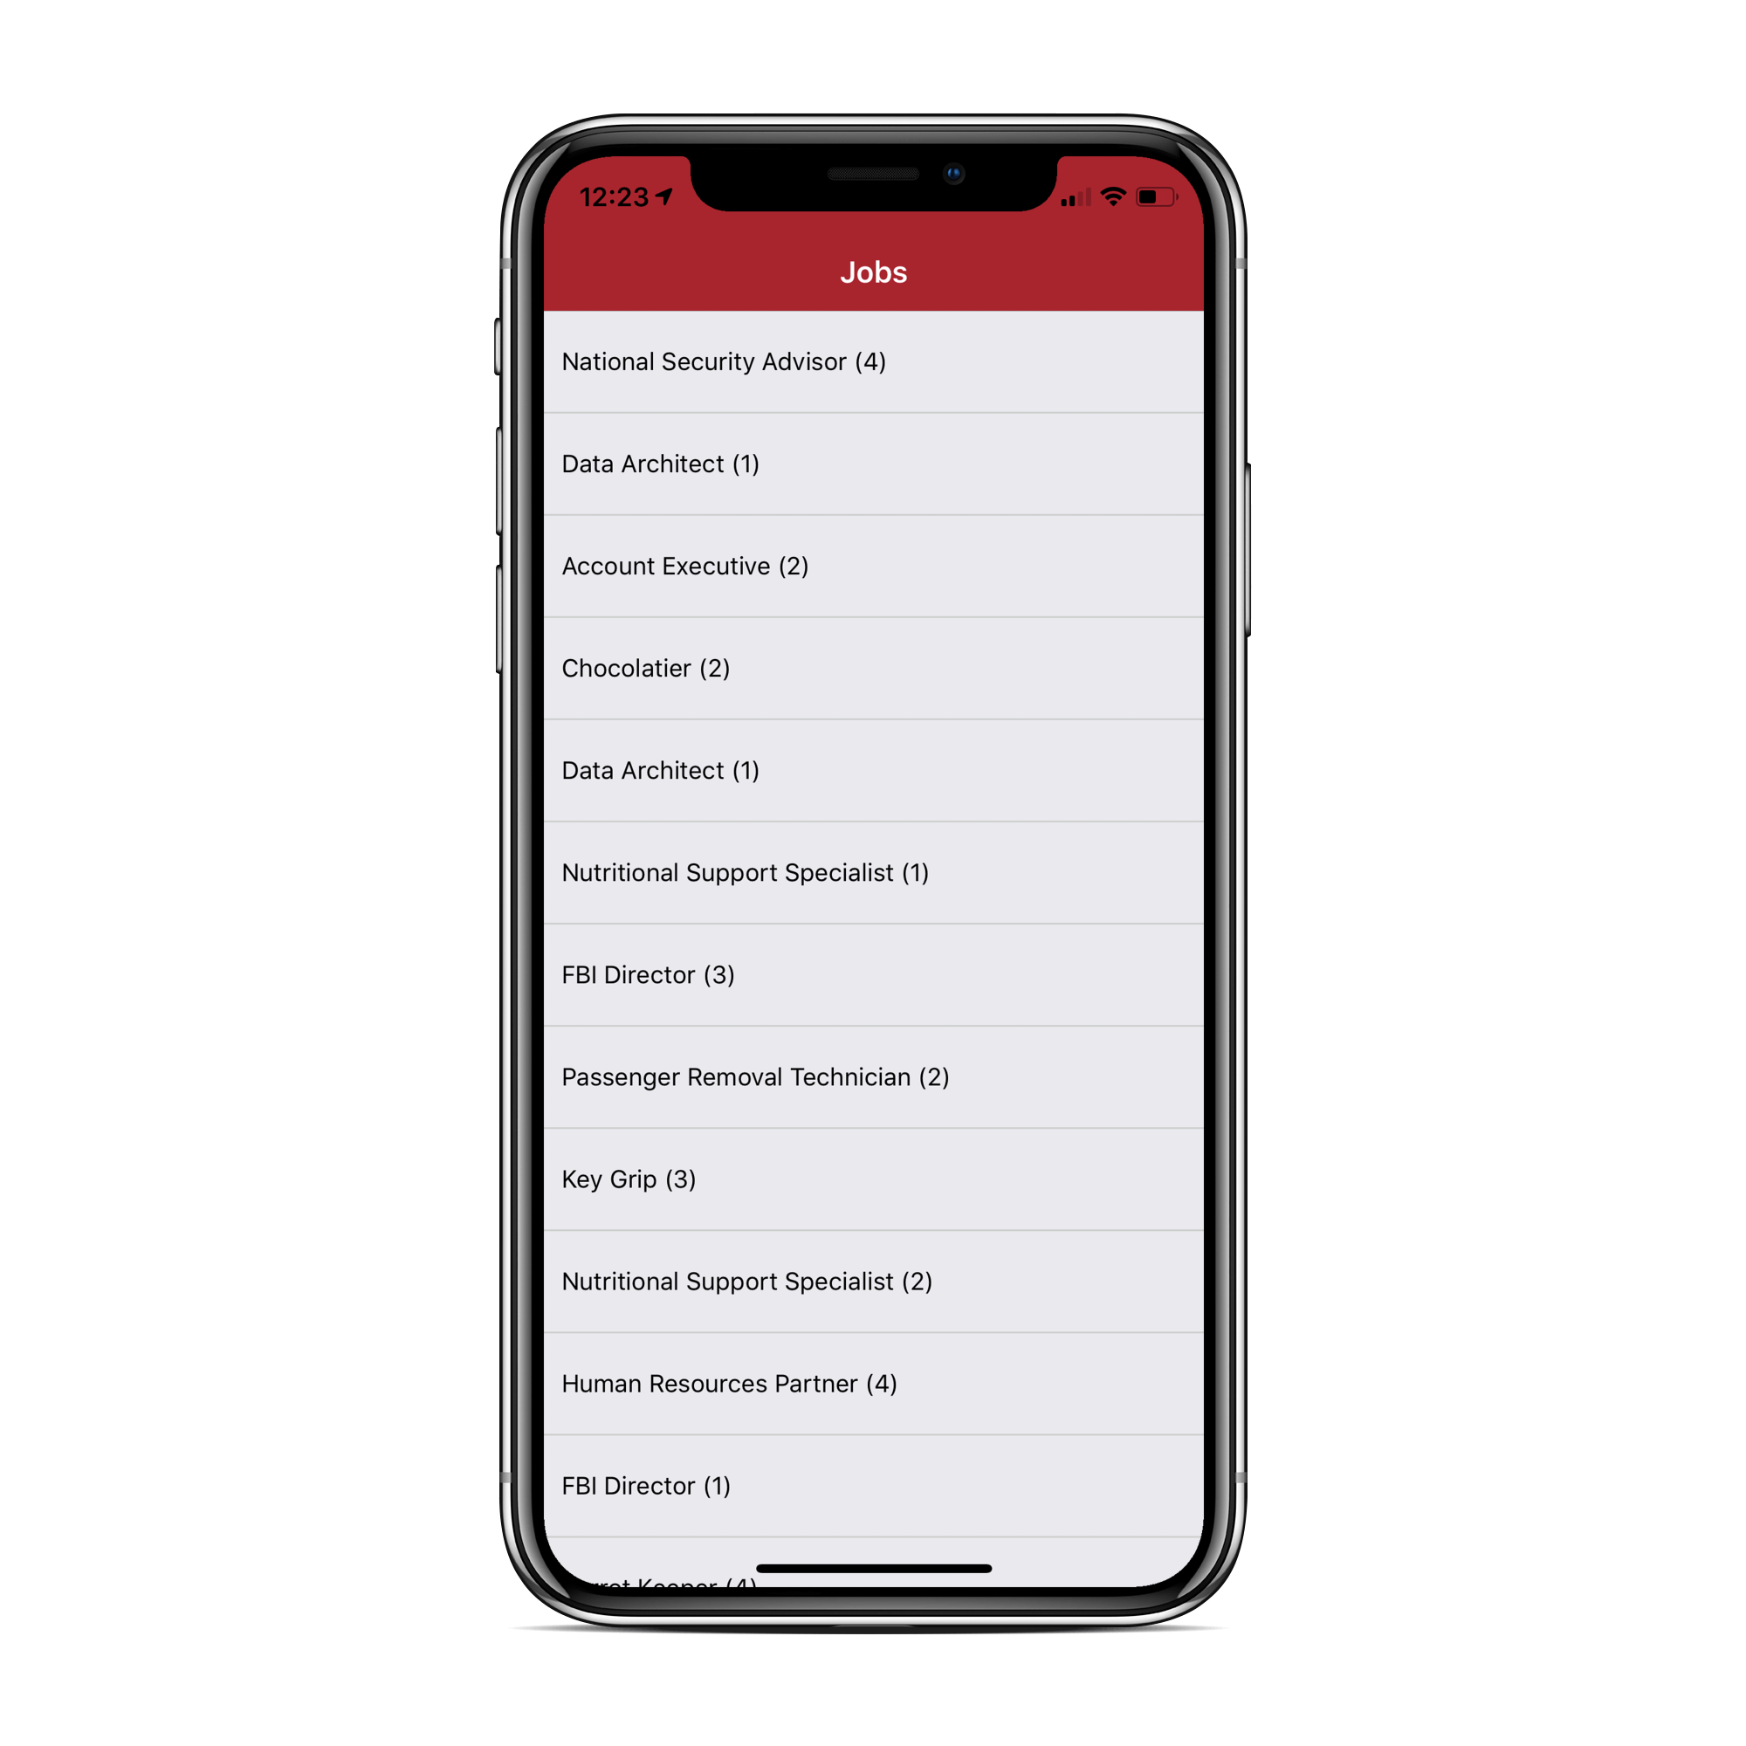
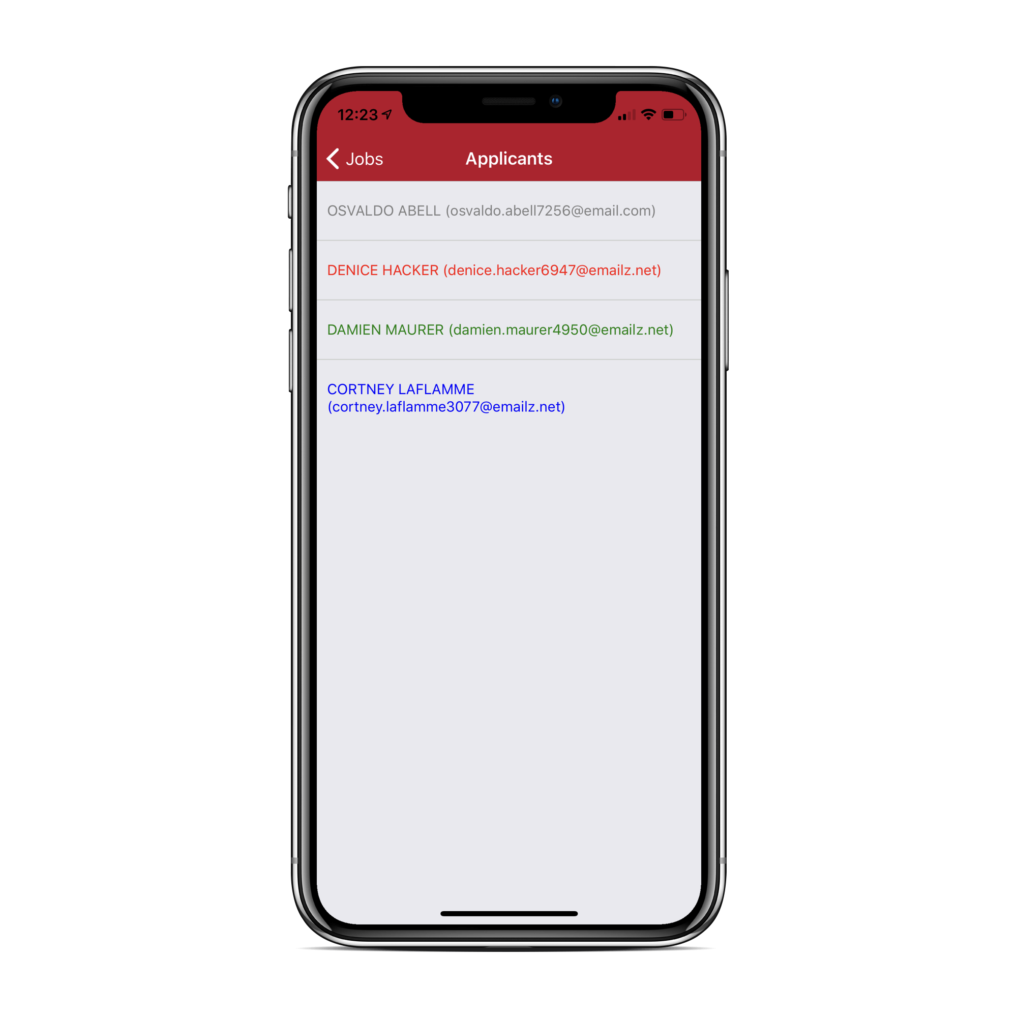
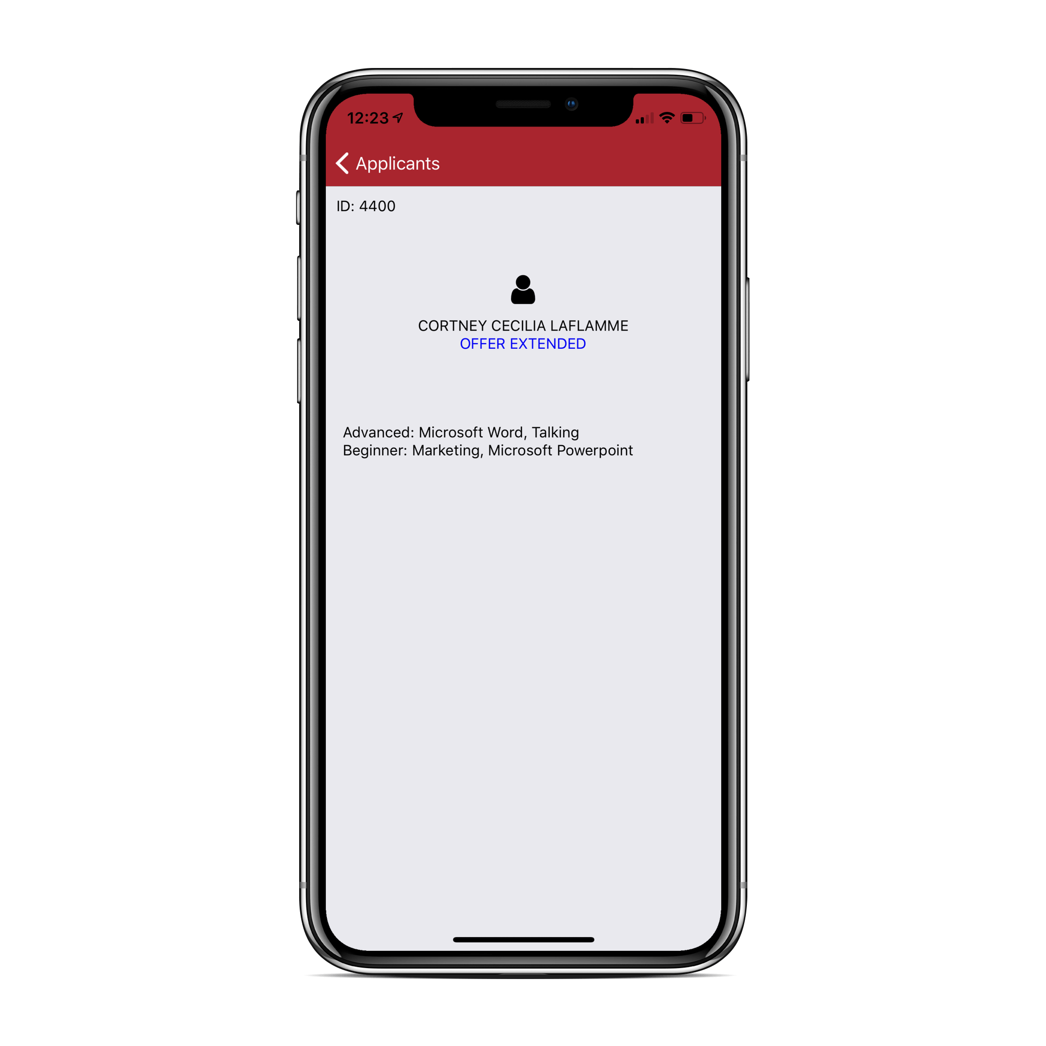
Job Applications App

Slide 11
iCIMS Hackathon API
Create a GitHub account
Create your company profile at hackicims.com
In the mean time… any questions so far?

Slide 12
Setup Development Environment
What is Expo http://expo.io ?
https://snack.expo.io/
https://snack.expo.io/@aalvarezp/rehack-native
GitHub: https://github.com/iCIMS-inc/intro-to-react-native
Make sure Node and NPM are installed https://nodejs.org
Install React Native and Expo: npm install -g expo-cli
npm install react-navigation

Slide 13
Diving into the Code
App
App.js (entry point)
Network/api.js
constants.js
Screens
Job List
Application List
Person Profile
Components
SkillsByLevelList

Slide 14
Advanced Topics
State Management with Redux
Problem Statement: Passing data around components can get messy.
React provides a Context API
Redux solution
What is it?
How does it work?
Static typing with Flow or Typescript
Problem Statement: Managing a large code base with dynamic typing can get messy with time.
Facebook came up with Flow.
Microsoft came up with Typescript.

Slide 15
Resources
GitHub Repository: https://github.com/iCIMS-inc/intro-to-react-native
Expo Snack: https://snack.expo.io/@aalvarezp/rehack-native
React Native: https://facebook.github.io/react-native/

Slide 16
Thanks!

